Slide 1

Networks Fundamentals
Mousa Al-Sahory

Slide 2
Chapter 7
Introduction
IPv4 Classes IP Subnetting VLSM
IP Summarization

Slide 3
IP
Addressing
Introduction

Slide 4
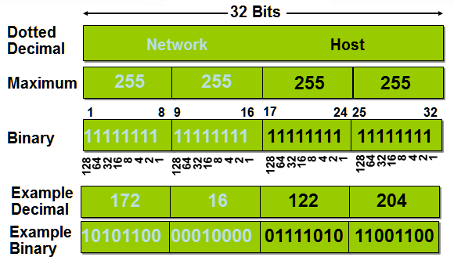
IP Addressing

Slide 5
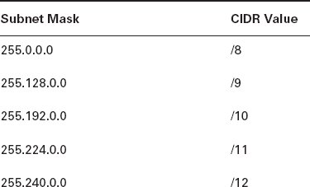
Subnet Masks & CIDR Values

Slide 6
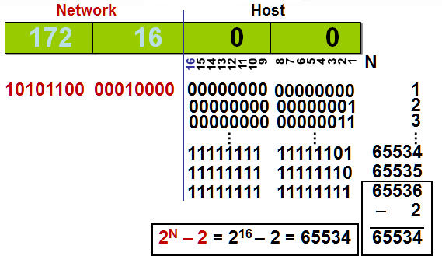
Determining Available Host Addresses

Slide 7
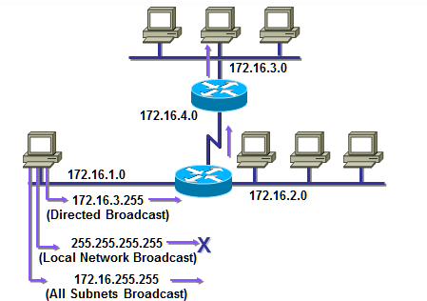
Broadcast Addresses

Slide 8
IP
Addressing
IPv4 Classes

Slide 9
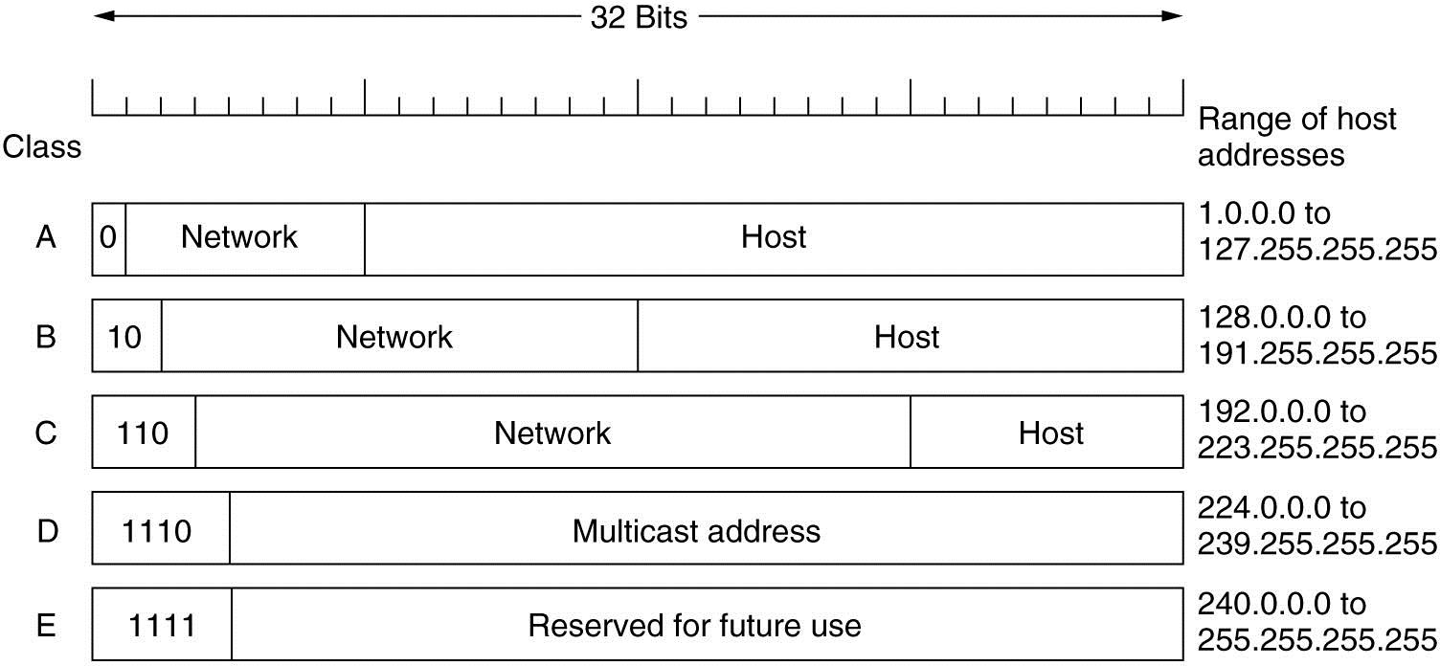
IPv4 Classes
IPv4 Classes

Slide 10
IPv4 Classes – Class A
Class A:
  Used for large networks.
  Format: Network.Host.Host.Host
o Netmask is 255.0.0.0 == /8
  Provides about 16.000.000 IP addresses.
  IP range for the first octet is (1-127).
  Note: 127 is not used since it is used for testing purposes.

Slide 11
IPv4 Classes – Class B
Class B:
  Used for intermediate networks.
  Format: Network.Network.Host.Host
o Netmask is 255.255.0.0 == /16
  Provides about 64.000 IP addresses.
  IP range for the first octet is (128-191).

Slide 12
IPv4 Classes – Class C
Class C:
  Used for small networks.
  Format: Network.Network.Network.Host
o Netmask is 255.255.255.0 == /24
  Provides 256 IP addresses (Only 254 can be used for hosts because two IP addresses are excluded as one is used as a network address and the other as a broadcast address)
  IP range for the first octet is (192-223).

Slide 13
IPv4 Classes – Class D
Class D:
  Used for multicasting purposes.
  The multicast addresses are in the range 224.0.0.0 through 239.255.255.255.
  Multicasting: sending data to hosts that belong to a multicast group.

Slide 14
IPv4 Classes – Class E
Class E:
o Used for research purposes & future use.
o Class E range is 240.0.0.0 through 255.255.255.255

Slide 15
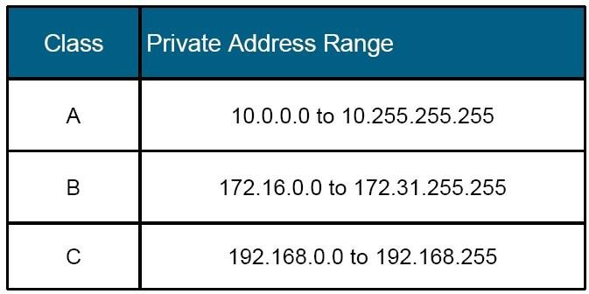
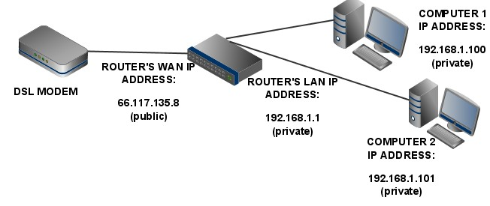
Private Addressing

Slide 16
IP
Addressing
IP Subnetting

Slide 17
IP Subnetting
Subnetting is logically dividing the network to sub networks
by increasing the 1’s used in the subnet mask
The main idea of subnetting is saving IP addresses and use them according to hosts number that will be used in the network.
Advantages
  Saving IPs
  Can divide network in smaller parts
  Restrict Broadcast traffic
  Security
  Simplified Administration

Slide 18
IP Subnetting
Example:
  192.168.10.0/24: provides 254 IP addresses.
  In your network you have 20 hosts.
  Without subnetting you will waste 234 IP addresses (254 – 20).
Why wasting ??
  The last octet of 192.168.10.0/24 consists of 8 bits.
  We have 20 hosts so we need to use only the last 5 bits of that octet since ((2⁵) – 2) = 30 which covers the 20 hosts.
  The remaining 3 bits will be added to the network part so that we have a /27 address.

Slide 19
IP Subnetting – Formula
Number of subnets – 2^{x}-2
Where X = number of bits borrowed
Number of hosts – 2^{y}-2
Where y = number of 0’s
Block Size = Total number of addresses
Block Size = 256-Mask

Slide 20
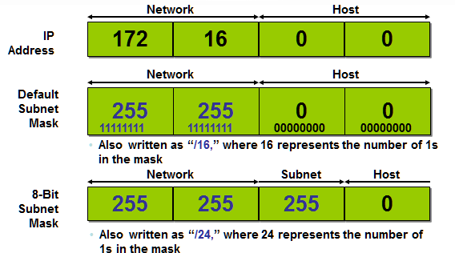
IP Subnetting – Subnet Mask

Slide 21
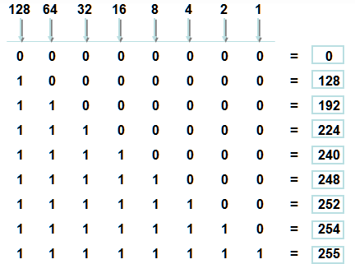
IP Subnetting – Subnet Mask
Possible subnet mask values

Slide 22
IP Subnetting – Subnet Mask
CIDR | Mask
/24 | 0
/25 | 128
/26 | 192
/27 | 224
/28 | 240
/29 | 248
/30 | 252

Slide 23
IP Subnetting – Example
Question: What are the subnet and broadcast addresses for the subnet which the IP 172.16.10.10 255.255.255.192 is a member of?
Answer:
  Find the block size
256 – 192 (last octet of the subnet mask) = 64. Block size = 64.
  Subnets are : 0, 64, 128, etc.
The last octet of the IP is 10 and 10 is in the 0 subnet.
  Then the subnet address is 172.16.10.0/26
  The broadcast address is always (the next subnet – 1)
Current subnet = 0, next subnet = 64 broadcast address = 172.16.10.63

Slide 24
IP Subnetting – Example
Question: What are the subnet and broadcast addresses for the subnet which the IP 172.16.88.20 255.255.240.0 is a member of?
Answer:
  256 – 240 = 16, so the block size is 16.0.
o Valid subnets are 16.0, 32.0, 48.0, …, 80.0, 96.0, etc.
  88.20 is within 80.0 subnet, so the subnet address is 172.16.80.0/20
  Next subnet is 172.16.96.0, (broadcast address = next subnet – 1) =
172.16.95.255

Slide 25
Addressing
IP
VLSM

Slide 26
VLSM
Stands for Variable Length Subnet Mask
Every subnet will have different subnet mask based on
requirement
VLSM is a method of designating a different subnet mask for
the same network number on different subnets
Can use a long mask on networks with few hosts and a
shorter mask on subnets with many hosts
With VLSMs we can have different subnet masks for
different subnets.

Slide 27
VLSM
Suppose we have the following networks:
  Network 1 with 60 hosts.
  Network 2 with 30 hosts.
  Network 3 with 10 hosts.
The network address is 200.50.60.0/24
After subnetting: we will have 4 subnets each with 62 IP
addresses.
Network 2 with 30 hosts and network 3 with 10 hosts will be assigned a subnet with 62 IP addresses and this will waste some IP addresses.
VLSM is used to save these IP addresses.

Slide 28
VLSM
We can say that VLSM is a subnetting for the subnetting.
In previous example, each subnet provides 62 IP addresses. For network 2 we need only 30 addresses and for network 3 we need only 10 addresses, so we do a subnetting for the subnet that provides 62 IP addresses.
Each subnet is a network in its own.

Slide 29
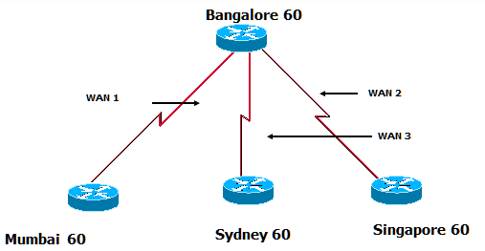
VLSM Example
VLSM allows us to use one class C (192.168.10.0/24) address to design a networking scheme to meet the following requirements:
Bangalore Mumbai Sydney Singapore WAN 1
WAN 2
WAN 3
60 Hosts
28 Hosts
12 Hosts
12 Hosts
2 Hosts
2 Hosts
2 Hosts
With normal subnetting a /26 mask was used to provide the 60 addresses for Bangalore and the other LANs. There are no addresses left for WAN links

Slide 30
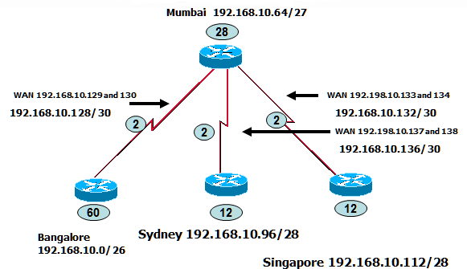
VLSM Example
With VLSM

Slide 31
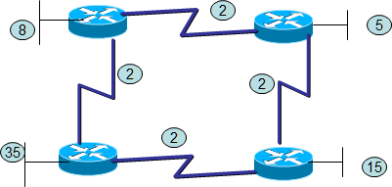
VLSM Exercise
192.168.1.0/24

Slide 32
Subnetting & VLSM Exercise
Find out the subnet and the broadcast addresses for each
subnet.
Network address: 200.10.10.0/24
You have 3 networks: Network 1 with 50 hosts. Network 2 with 20 hosts. Network 3 with 10 hosts.
Do it with normal subnetting and then with VLSM

Slide 33
IP
Addressing
IP Summarization

Slide 34
IP Summarization
Summarization, also called route aggregation, allows routing
protocols to advertise many networks as one address.
The purpose of this is to reduce the size of routing tables on
routers to save memory
Route summarization (also called Route Aggregation or Supernetting) can reduce the number of routes that a router must maintain
Route summarization is possible only when a proper
addressing plan is in place
Route summarization is most effective within a subnetted environment when the network addresses are in contiguous blocks

Slide 35
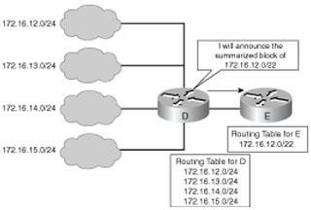
IP Summarization

Slide 36
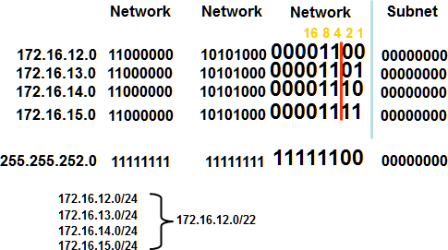
IP Summarization

Slide 37
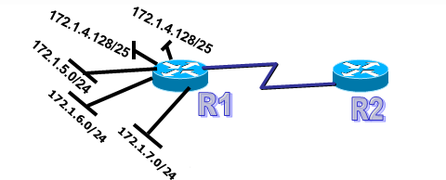
IP Summarization Exercise
What is the most efficient summarization that R1 can use to
advertise its networks to R2?
A. 172.1.4.0/24 - 172.1.5.0/24 - 172.1.6.0/24 - 172.1.7.0/24
B. 172.1.0.0/22
C. 172.1.4.0/25 - 172.1.4.128/25 - 172.1.5.0/24 - 172.1.6.0/24 - 172.1.7.0/24
D. 172.1.0.0/21
E. 172.1.4.0/22

Slide 38
Q&A

